Slide 1
Reference Guide for Web Elements
StudentID_40479968

Slide 2
Directory Structure
Group03/
├── Database/
│ ├── create.sql
│ └── insert.sql
├── Web App/
│ ├── AddHTML
│ ├── CSS
│ ├── DataHTML
│ ├── EditHTML
│ ├── HTML
│ ├── Images
│ └── JS
├── Database_Technical_Documentation.docx
│
├── Group_System_Video.mp4
│
├── Work_Breakdown_Table.docx
│
├── 40479966/
│ ├── 40479966 _Design_Spec.docx
│ ├── 40479966 _reports.sql
│ ├── 40479966 _Web_Reference_PPT.pptx
│ ├── 40479966 _Individual_Video.mp4
│ └── 40479966 _GenAi_Log.docx
├── 40479968/
│ ├── 40479968 _Design_Spec.docx
│ ├── 40479968 _ reports.sql
│ ├── 40479968 _Web_Reference_PPT.pptx
│ ├── 40479968 _Individual_Video.mp4
│ └── 40479968 _GenAi_Log.docx
├── 40486524/
│ ├── 40486524 _Design_Spec.docx
│ ├── 40486524 _ reports.sql
│ ├── 40486524 _Web_Reference_PPT.pptx
│ ├── 40486524 _Individual_Video.mp4
│ └── 40486524 _GenAi_Log.docx
├── StudentID_40479966/
│ ├── 40479966 _Design_Spec.docx
│ ├── 40479966 _ reports.sql
│ ├── 40479966 _Web_Reference_PPT.pptx
│ ├── 40479966 _Individual_Video.mp4
│ └── 40479966 _GenAi_Log.docx
└── StudentID_40479969/
│ ├── 40479969 _Design_Spec.docx
│ ├── 40479969 _ reports.sql
│ ├── 40479969 _Web_Reference_PPT.pptx
│ ├── 40479969 _Individual_Video.mp4
│ └── 40479969 _GenAi_Log.docx

Slide 3
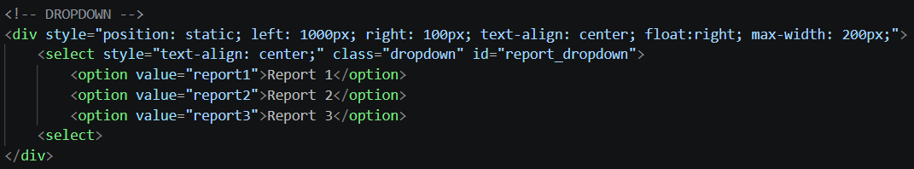

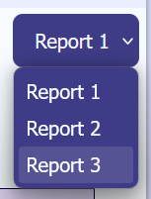
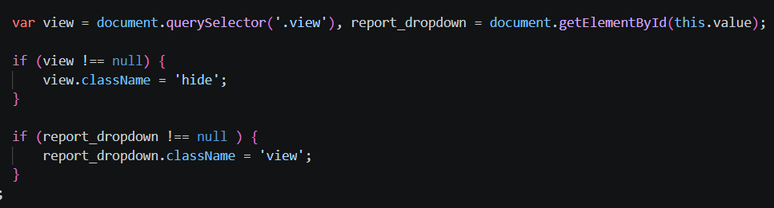
Report Reference Index
…\Data-Driven-2026\Web App\DataHTML\EmmaData
…\Data-Driven-2026\Web App\JS\ReportJS\emmaReports
…\Data-Driven-2026\40479968\40479968_Reports
Internal view – creation of the dropdown selection in EmmaData.html
Div containing second report with its class name currently set to “hide”
CSS will now not display anything with the class name of “hide”
External view - report dropdown selection on the web application
Building tables in JS
Using a dropdown selection to choose which report to view
Non-selected reports will be hidden using an eventListener and CSS
Contents of eventListener on the dropdown to change the className of the report divs depending on the dropdown selection

Slide 4
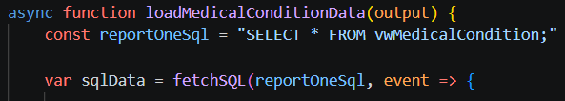
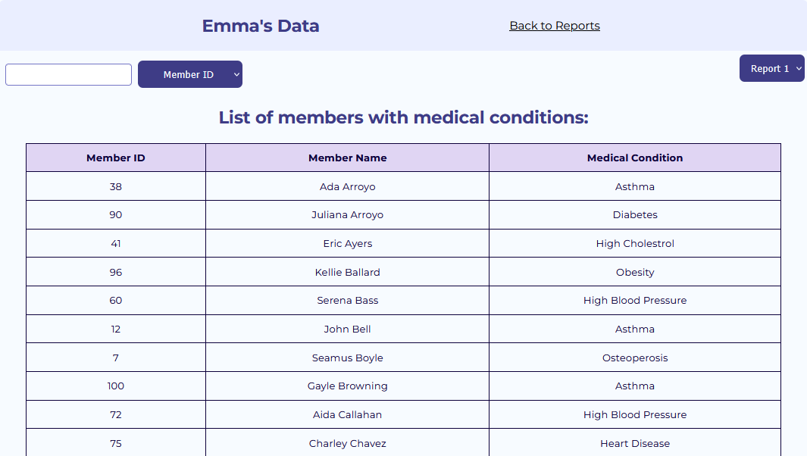
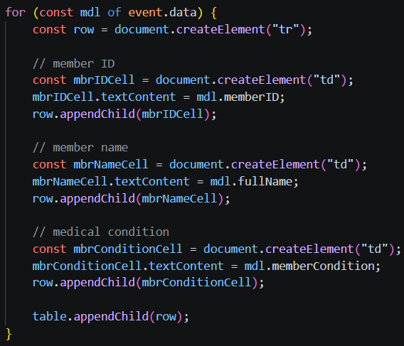
FIRST REPORT
Fetching the SQL view to display its contents in the table
What the tabular report looks like in the web application (first ten rows)
Creation of the table in JS

Slide 5
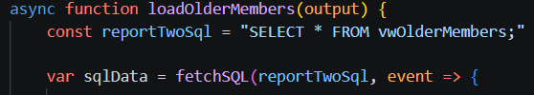
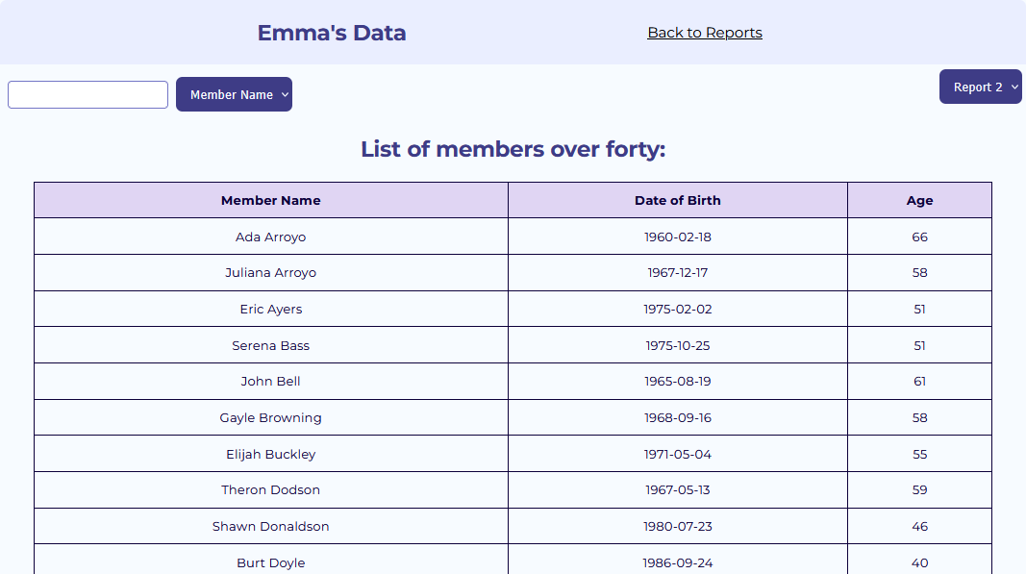
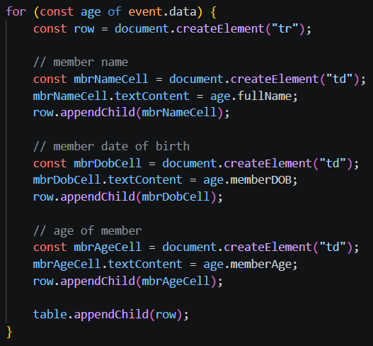
SECOND REPORT
Fetching the SQL view to display its contents in the table
What the tabular report looks like in the web application (first ten rows)
Creation of the table in JS

Slide 6
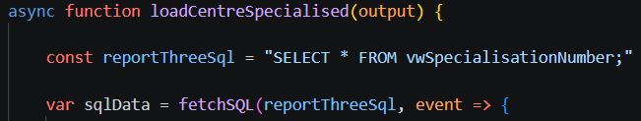
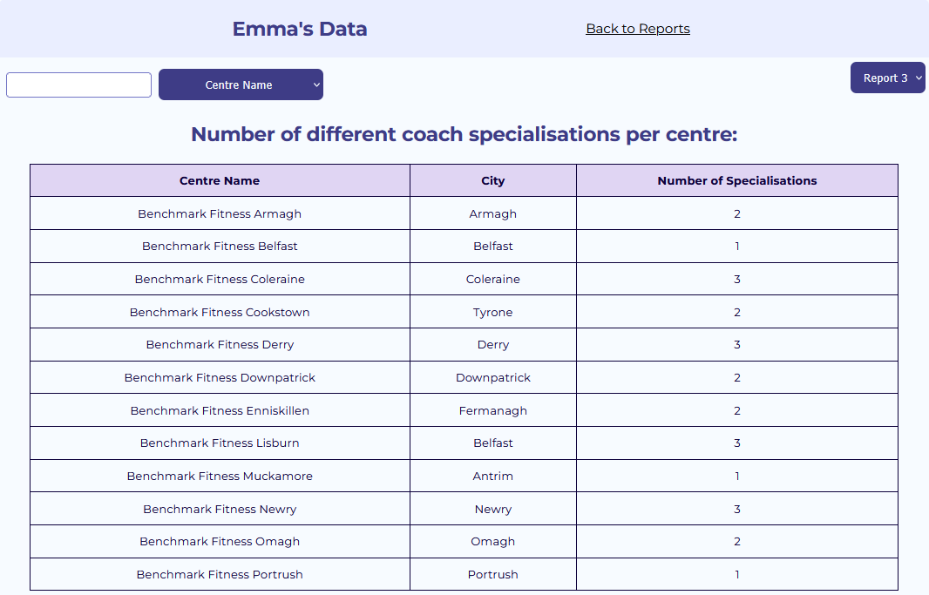
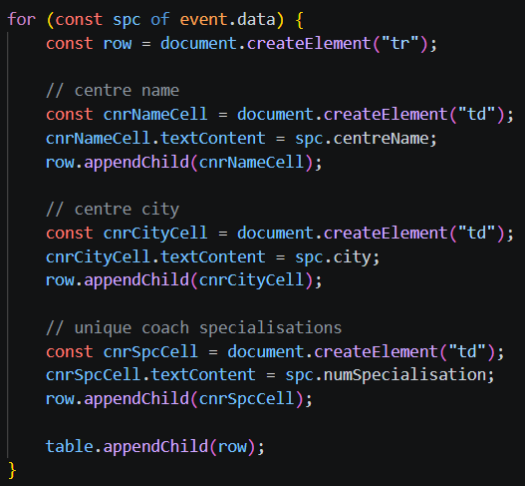
THIRD REPORT
Fetching the SQL view to display its contents in the table
What the tabular version of the report looks like in the web application
Creation of the table in JS

Slide 7
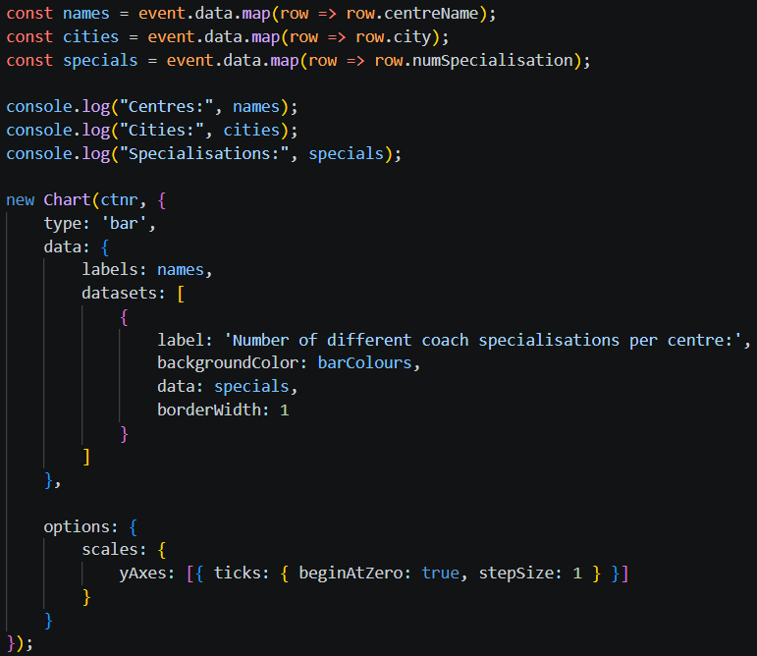
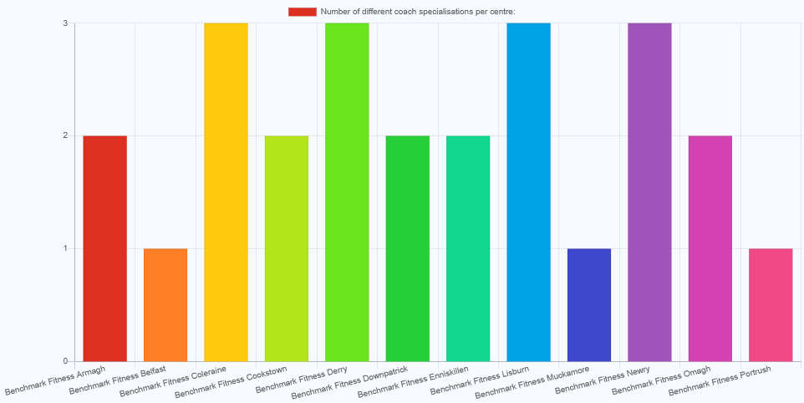
THIRD REPORT
What the bar chart of the report looks like in the web application – makes use of chart.js and CDN
Creation of the bar chart in JS

Slide 8
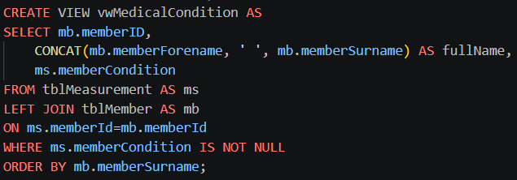
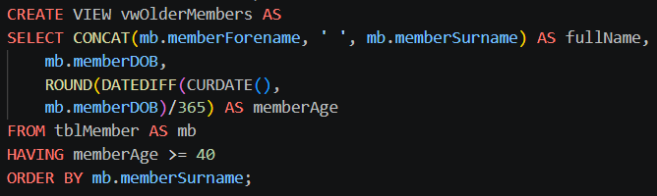
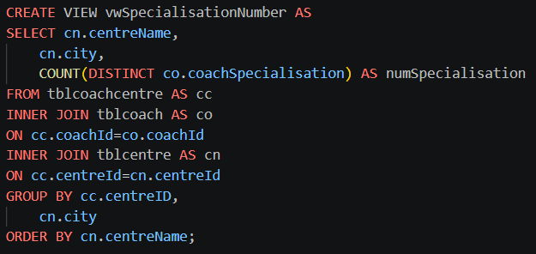
View Reference Index
…\Data-Driven-2026\40479968\40479968_Reports
First query
SQL queries using views for data aggregation and access protection
Making use of different SQL constraints such as ROUND() and COUNT()
First query to select all members with medical conditions
Second query to select all members over forty
Third query to count how many coach specialisations are registered at each centre
Second query
Third query

Slide 9
Turning the query below into a view called “vwMedicalCondition”
Concatenating the two name fields into one “fullName”
Selecting the relevant fields to be displayed later
Joining the member table to the measurement table using their shared field – “memberId”
The fields come from the most relevant table
The condition of the query – selecting non-null values of memberCondition only
The results of the query will be displayed by surnames in alphabetical order

Slide 10

Concatenating the two name fields into one “fullName”
Turning the query below into a view called “vwOlderMembers”
Selecting the relevant fields to be displayed later
DATEDIFF() is used to compare the time between the current date and the member’s DoB
All fields come from the member table
ROUND() is used to round up the number calculated by the DATEDIFF after being converted from days to years
The condition of the query (using HAVING as the value was created within the query) – selecting members whose age is over or equal to 40
The results of the query will be displayed by surnames in alphabetical order

Slide 11

Turning the query below into a view called “vwSpecialisationNumber”
Selecting the relevant fields to be displayed later
COUNT() is used to add up the number of specialisations
DISTINCT is used to count only unique specialisations that are not already counted
The fields come from tblCoachCentre to link the two relevant tables together
Two INNER JOINS needed to link the coach and centre to their respective FOREIGN KEYS in tblCoachCentre
The results will be grouped by centreID then city
The results of the query will be displayed by centre name in alphabetical order

Slide 12
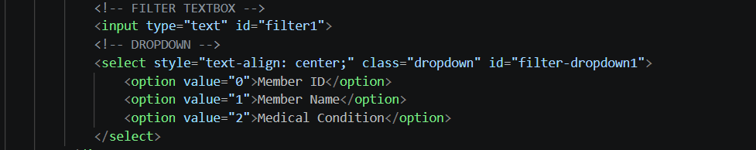
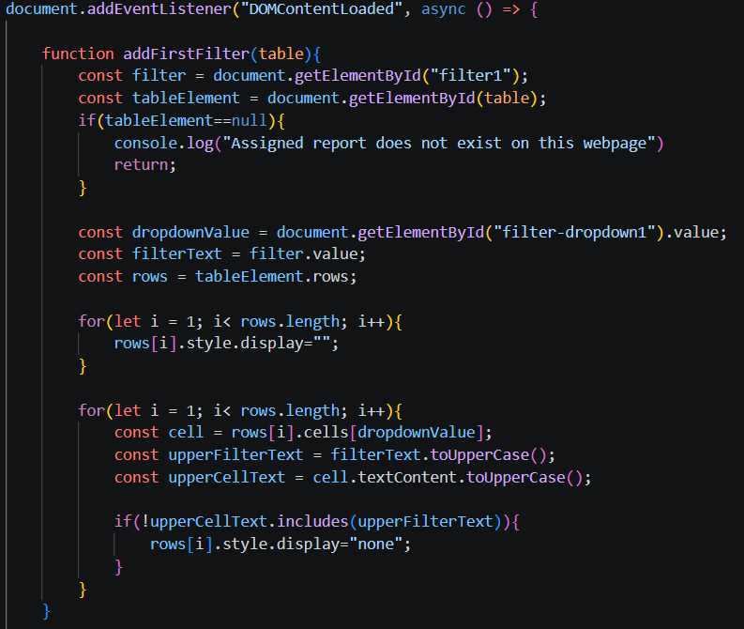
Parameterised Reporting Reference Index
…\Data-Driven-2026\Web App\DataHTML\EmmaData
…\Data-Driven-2026\Web App\JS\ReportJS\emmaReports
…\Data-Driven-2026\40479968\40479968_Reports
Input textbox and column selection dropdown in HTML
Error handling to provide feedback to the user if there has been a problem loading the webpage
Tabular reports make use of an input box and dropdown box to filter through the table columns
Removing the current display of rows

Slide 13
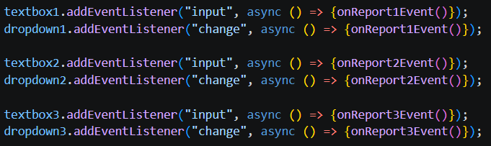
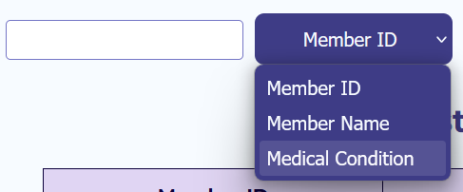
Parameterised reports
First select the column of the table you want to filter by
Then enter your desired search request into the search bar
Table will automatically update and display the correct records if there is a match
Allows the user to dynamically interact with the reports to further provide more meaningful data
Searches through the reporting table for a match to the user input in the textbox
EventListener for each report – waits on input in the search bar and/or a change in selection of the dropdown
Screenshot of the search bar and column toggle

Slide 14
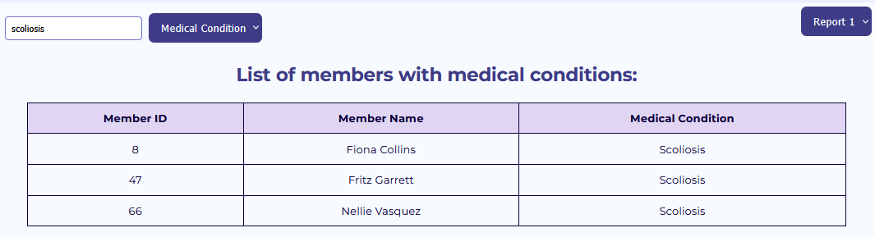
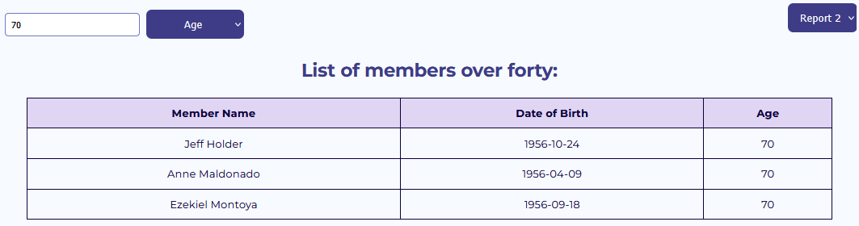
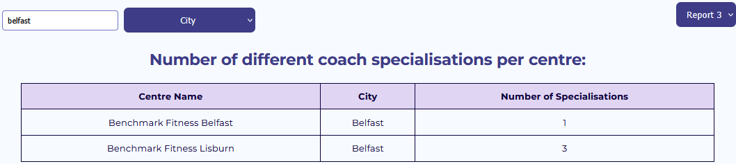
Examples
First report – displaying all members the medical condition “Scoliosis”
Second report – displaying all members who are 70 years old
Third report – displaying all centres in Belfast
First report
Second report
Third report

